Slide 1

Linear Regression
Dr. Singara Singh Kasana
Associate Professor
Computer Science and Engineering Department
Thapar Institute of Engineering and Technology
Patiala, Punjab

Slide 2
Area of House (in Sq Yards) | No. of Bed Room | Location | Price (in Lakhs)
200 | 3 | Chandigarh | 62.0
300 | 4 | Chandigarh | 75.0
400 | 5 | Delhi | 120.50
300 | 4 | Delhi | 95.25
200 | 3 | Patiala | 45.50
Total Features =4
Total Instances =5

Slide 3
Labeled Dataset
Area of House | No of Bed Rooms | Location | Price (in Lakhs)
200 | 3 | Chandigarh | 65.0
300 | 4 | Chandigarh | 75.0
400 | 5 | Delhi | 120.50
300 | 4 | Delhi | 95.25
200 | 3 | Patiala | 45.50
Relationship between input features Xi and output feature y
y=f(X)

Slide 4
Unlabeled Dataset
Emp Id | Experience (in Years) | Age | Address
101 | 12 | 34 | Patiala
102 | 24 | 47 | Delhi
103 | 16 | 42 | Delhi
104 | 14 | 36 | Chandigarh
105 | 16 | 39 | Chandigarh
106 | 21 | 42 | Chandigarh

Slide 5
Types of Features
Qualitative Feature
Quantitative Feature
Qualitative or categorical features have non numerical values. E.g. Gender(male or female).
They can’t be measured, but can be grouped.
Quantitative features are numerical in nature. E.g. Salary of a person, Marks obtained by a student.
They are measurable and have some order.

Slide 6
Qualitative feature
Nominal feature
Ordinal feature
Nominal feature has no numerical values as well as ordering to its categories. For example, gender is a nominal.
Ordinal feature has a clear ordering. Education level is an ordinal variable as it may be have values- Elementary, Secondary, College/University.

Slide 7
Quantitative feature
Discrete feature
Continuous feature
Discrete Feature: It can take finite number of values only. Number of daily admitted patients to a hospital .
Continuous Feature: It can be measured on a continuum or a scale. For example- Price of a house, weight of a person, blood pressure of a patient etc.

Slide 8
Regression
Regression is a statistical method used to find the relationship between one dependent variable and a series of other variables.
It attempts to model an output feature between output feature and input features by fitting an equation to the observed data.
It is supervised machine learning approach.

Slide 9
Regression
Regression is a method of modelling a output feature based on input features.
It finds a relationship between output and input features.
Simple Regression
Simple Linear Regression
Simple Non-Linear Regression
Multiple Regression
Multiple Linear Regression
Multiple Non-Linear Regression

Slide 10
Linear Regression
Linear regression is a linear model, e.g. a model that assumes a linear relationship between the input variables (x) and the single output variable (y). More specifically, that y can be calculated from a linear combination of the input variables (x).
Examples of Linear Regression are:
Predicting price of a house on the basis of rooms
Predicting salary of a person on the basis of his experience

Slide 11
Example of Non Linear Regression
Nonlinear regression relates input variables (x) and the single output variable (y) in a nonlinear (curved) relationship.
Example:
Prediction of population growth over time. A scatterplot of changing population data over time shows that there seems to be a relationship between time and population growth, but that it is a nonlinear relationship, requiring the use of a nonlinear regression model. A logistic population growth model can provide estimates of the population for periods that were not measured, and predictions of future population growth.

Slide 12
Linear Regression
Nonlinear regression and linear regression models are similar in one sense that both seek to track a particular response(output) from a set of variables(input) graphically.
Nonlinear models are more complicated than linear models to develop because the function is created through a series of approximations (iterations) that may stem from trial-and-error. Mathematicians use several established methods, such as the Gauss-Newton method and the Levenberg-Marquardt method.

Slide 13
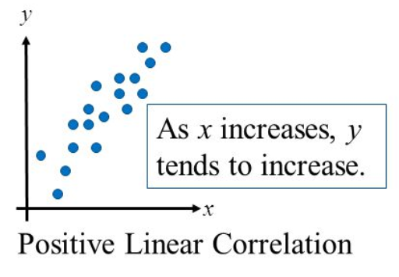
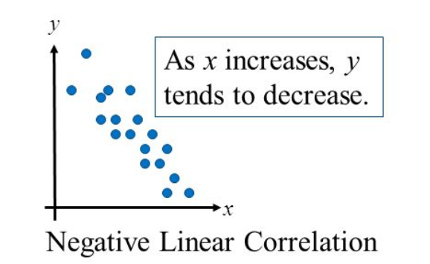
Linear Regression
You have to make sure that a linear relationship exists between the dependent feature and the independent feature(s).
Figure 1(a)
Figure 1(b)

Slide 14
Linear regression
Given an input feature x, compute an output feature y
Output feature is of continuous type.
For example:
- Predict height from age
- Predict house price from
number of bed rooms
Y
X

Slide 15
X: No of Bed Rooms | Y: Price(in Lacs)
5 | 101.5
3 | 79.9
5 | 99.87
3 | 56.9
2 | 66.6
5 | 105.45
5 | 126.3
4 | 89.25
5 | 99.97
3 | 87.6
4 | 112.6
3 | 85.6
3 | 78.5
2 | 74.3
2 | 74.8

Slide 16
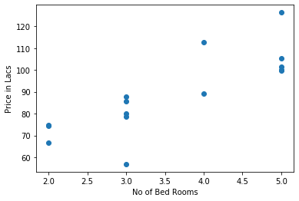
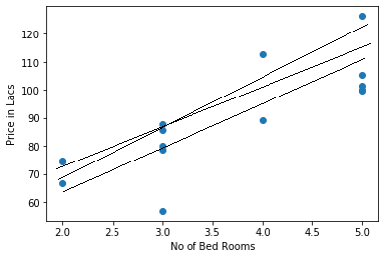
Figure 2(a)
Figure 2(b)

Slide 17
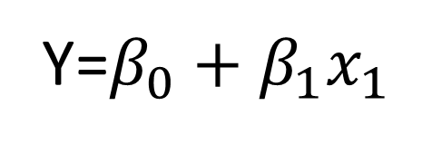
Simple Linear Regression Equation
Y
Regression line represents the relationship between independent variable x and the dependent variable y.
Regression line
Y=$β_{0}+β_{1}x_{1}$
In regression, the output feature is continuous However, the independent variable can be measured on continuous or categorical values.
Slope β₁
Intercept
β₀
This line is known as slope-intercept form
x

Slide 18
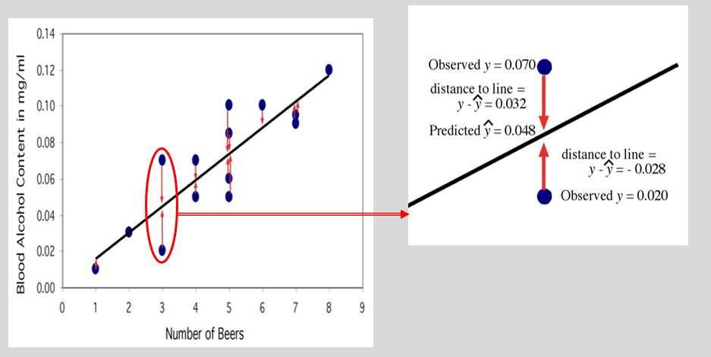
Regression Line
The regression line is the unique line such that the sum of the squared vertical (y) distances between the data points and the line is the smallest possible.

Slide 19
Objectives of Simple Linear Regression
Model the relationship between the two variables.
Prediction of the output for new instances

Slide 20
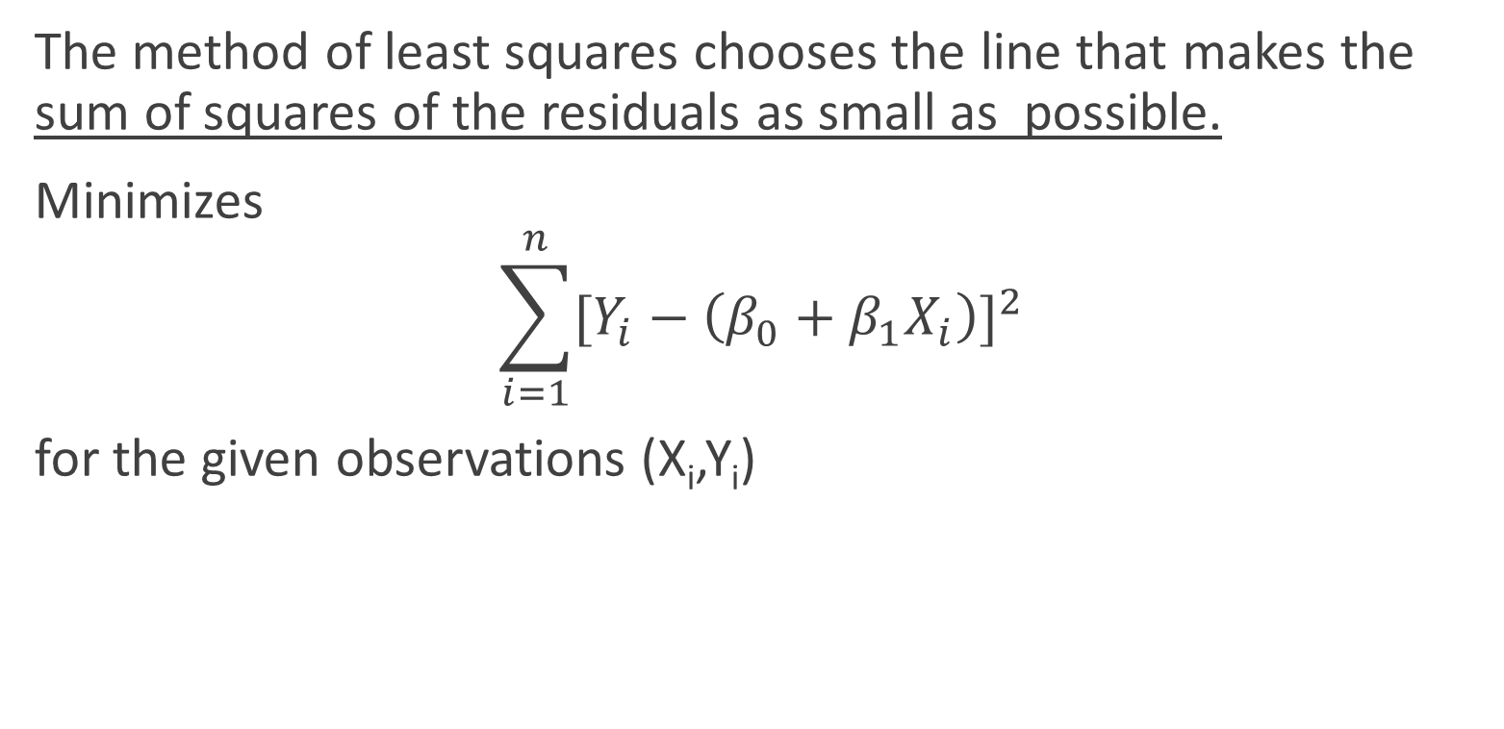
Criterion for choosing what line to draw: method of least squares
The method of least squares chooses the line that makes the sum of squares of the residuals as small as possible.
Minimizes
$$\sum_{i=1}^{n}{{[Y_{i}−\left(β_{0}+β_{1}X_{i}\right)]}^{2}}$$
for the given observations (X_{i},Y_{i})

Slide 21
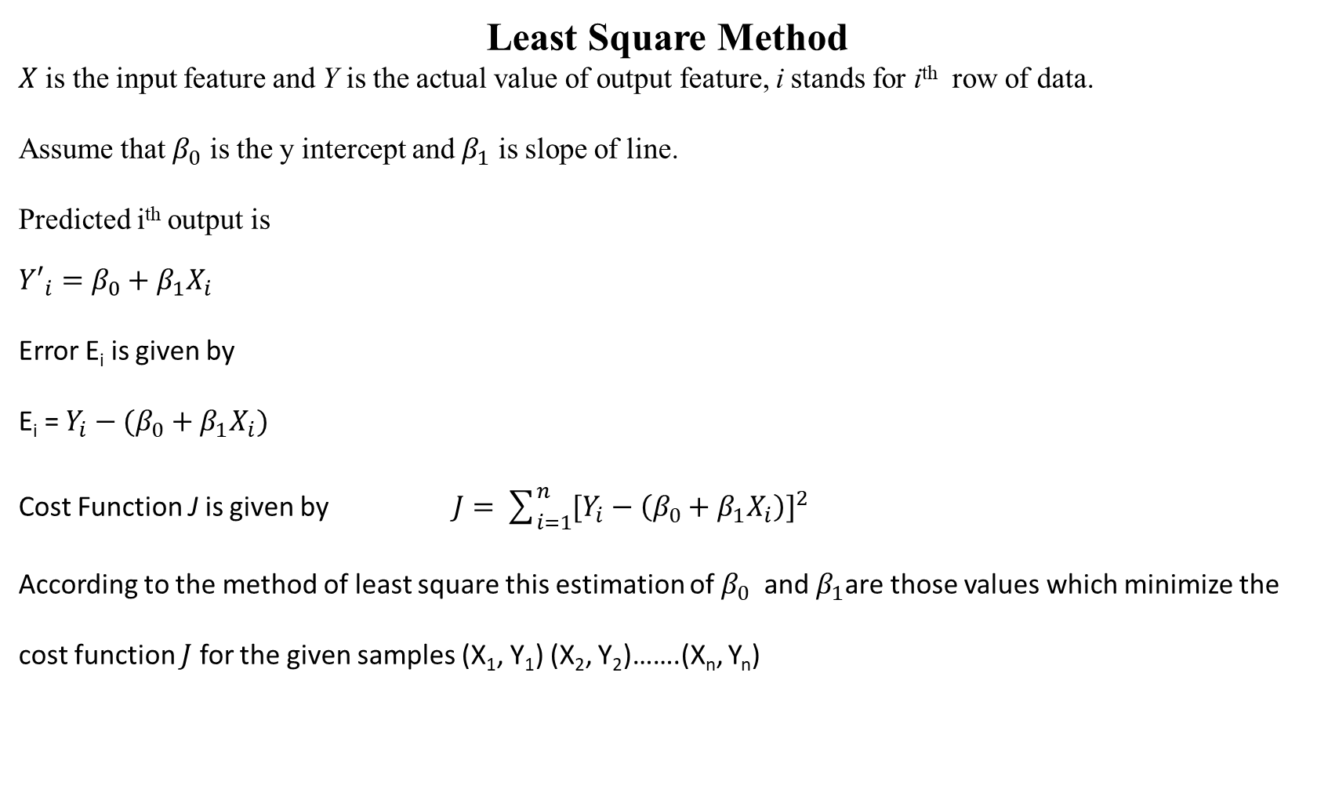
Least Square Method
$X$ is the input feature and Y is the actual value of output feature, i stands for i^{th} row of data.
Assume that $β_{0}$ is the y intercept and $β_{1}$ is slope of line.
Predicted i^{th} output is
$${Y′}_{i}=β_{0}+β_{1}X_{i}$$
Error E_{i} is given by
E_{i} = $Y_{i}−(β_{0}+β_{1}X_{i})$
Cost Function J is given by $J=\sum_{i=1}^{n}{{[Y_{i}−\left(β_{0}+β_{1}X_{i}\right)]}^{2}}$
According to the method of least square this estimation of $β_{0}$ and $β_{1}$are those values which minimize the cost function $J$ for the given samples (X₁, Y₁) (X₂, Y₂)…….(X_{n}, Y_{n})

Slide 22

J should be minimum, so
$$\frac{δJ}{δβ_{0}}=−2 \sum{[Y_{i}−(β_{0}+β_{1}X_{i})]}$$
$$\frac{δJ}{δβ_{1}}=−2 \sum{X_{i} (Y_{i}−β_{0}+β_{1}X_{i})}$$
Equating the partial derivatives of $J$ to 0, we get
$$\sum{[Y_{i}−(β_{0}+β_{1}X_{i})]}=0$$
$$\sum{X_{i} (Y_{i}−β_{0}+β_{1}X_{i})}=0$$

Slide 23
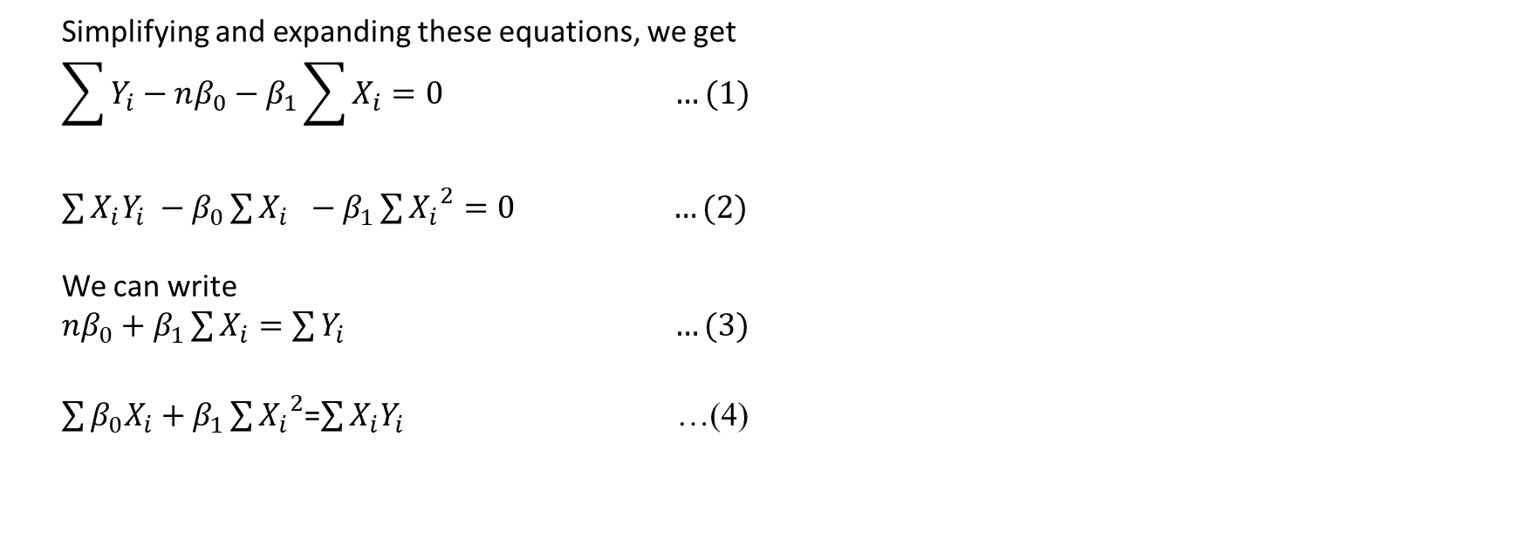
Simplifying and expanding these equations, we get
$$\sum{Y_{i}}−nβ_{0}−β_{1}\sum{X_{i}=0} …(1)$$
$\sum{X_{i}Y_{i}} −β_{0}\sum{X_{i} −β_{1}\sum{{X_{i}}^{2}}=0}$ $…(2)$
We can write
$nβ_{0}+β_{1}\sum{X_{i}}=\sum{Y_{i}}$ $…(3)$
$\sum{β_{0}X_{i}+β_{1}}\sum{{X_{i}}^{2}}$=$\sum{X_{i}Y_{i}}$ …(4)

Slide 24
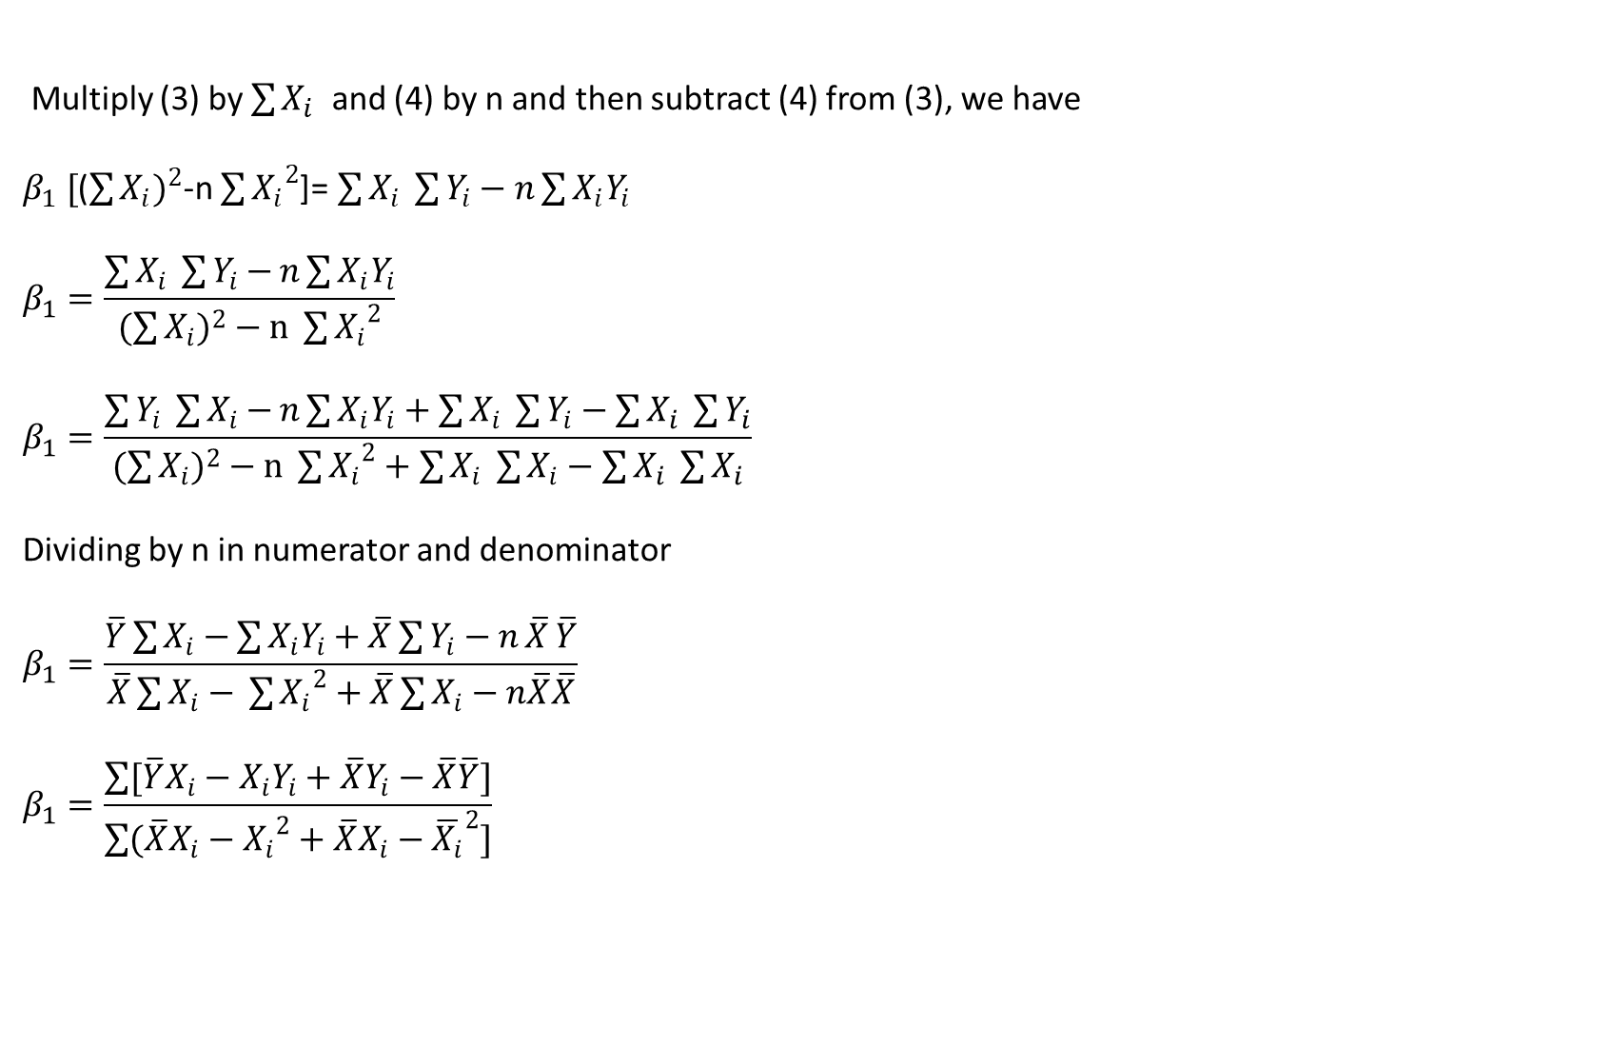
Multiply (3) by $\sum{X_{i} }$ and (4) by n and then subtract (4) from (3), we have
$β_{1} [$($\sum{{X_{i})}^{2}}$-n $\sum{{X_{i}}^{2}}$]=$\sum{X_{i} }\sum{Y_{i}−n}\sum{X_{i}Y_{i}}$
$$β_{1}=\frac{\sum{X_{i} }\sum{Y_{i}−}n\sum{X_{i}Y_{i}}}{(\sum{{X_{i})}^{2}}−n \sum{{X_{i}}^{2}}}$$
$$β_{1}=\frac{\sum{Y_{i} }\sum{X_{i}−}n\sum{X_{i}Y_{i}+\sum{X_{i} }\sum{Y_{i}−\sum{X_{i} }\sum{Y_{i}}}}}{(\sum{{X_{i})}^{2}}−n \sum{{X_{i}}^{2}}+\sum{X_{i} }\sum{X_{i}}−\sum{X_{i} }\sum{X_{i}}}$$
Dividing by n in numerator and denominator
$$β_{1}=\frac{\overline{Y}\sum{X_{i}−}\sum{X_{i}Y_{i}+\overline{X}\sum{Y_{i}−n}\overline{X}}\overline{Y}}{\overline{X}\sum{X_{i}−} \sum{{X_{i}}^{2}}+\overline{X}\sum{X_{i}}−n\overline{X}\overline{X}}$$
$$β_{1}=\frac{\sum{[\overline{Y}X_{i}−X_{i}Y_{i}+\overline{X}Y_{i}−\overline{X}\overline{Y}]}}{\sum{(\overline{X}X_{i}−{X_{i}}^{2}+\overline{X}X_{i}−{\overline{X_{i}}}^{2}]}}$$

Slide 25

$$β_{1}=\frac{\sum{[X_{i}\left( \overline{Y}−Y_{i}\right)−\overline{X} (Y_{i}−\overline{Y})]}}{−\sum{[{X_{i}}^{2}−2\overline{X}X_{i}+{\overline{X_{i}}}^{2}]}}$$
$$β_{1}=\frac{−\sum{[{(X}_{i}−\overline{X}) (Y_{i}−\overline{Y})]}}{−\sum{[{X_{i}}^{2}−2\overline{X}X_{i}+{\overline{X_{i}}}^{2}]}}$$
$β_{1}=\frac{\sum{[{(X}_{i}−\overline{X}) (Y_{i}−\overline{Y})]}}{\sum{{{(X}_{i}−\overline{X})}^{2}}}$ . . . (5)

Slide 26

Using(1), to get value of $β_{0}$
$$\sum{Y_{i}}−nb_{0}−β_{1}\sum{X_{i}=0}$$
$$β_{0}=\frac{\sum{Y_{i}−β_{1}\sum{X_{i}}}}{n}$$
$$β_{0}=\frac{\sum{Y_{i}}}{n}−β_{1}\frac{\sum{X_{i}}}{n}$$
$β_{0}=\overline{Y}−β_{1}\overline{X}$ . . .(6)
By using these coefficients in the equation
$${Y′}_{i}=β_{0}+β_{1}X_{i}$$

Slide 27

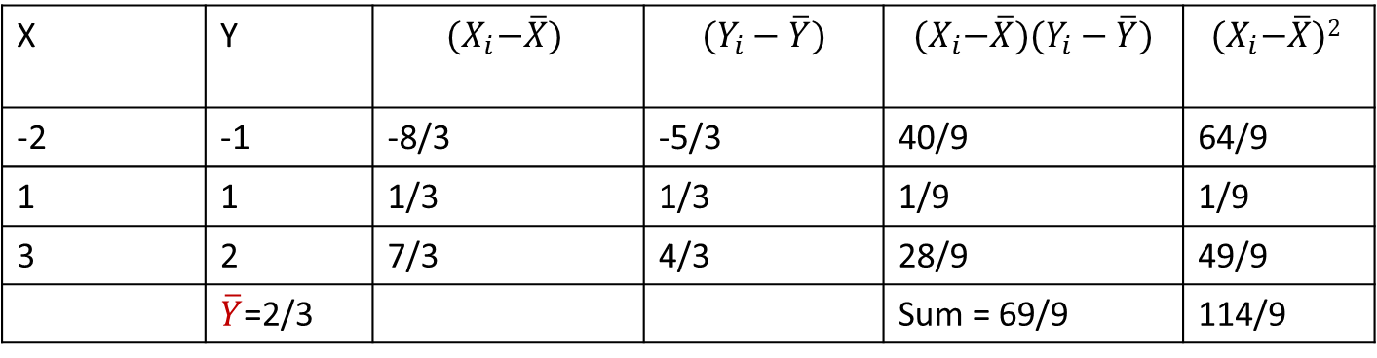


Numerical Example on Least Square
X | Y | $${(X}_{i}−\overline{X})$$ | $$(Y_{i}−\overline{Y})$$ | $${(X}_{i}−\overline{X})(Y_{i}−\overline{Y})$$ | $${(X}_{i}−\overline{X})2$$
-2 | -1 | -8/3 | -5/3 | 40/9 | 64/9
1 | 1 | 1/3 | 1/3 | 1/9 | 1/9
3 | 2 | 7/3 | 4/3 | 28/9 | 49/9
 | $\overline{Y}$=2/3 |  |  | Sum = 69/9 | 114/9
$\overline{X}$=2/3
$β_{1}$ = 69/114 = 23/38 = 0.6052
$β_{0}=5/19$ = 0.2631

Slide 28
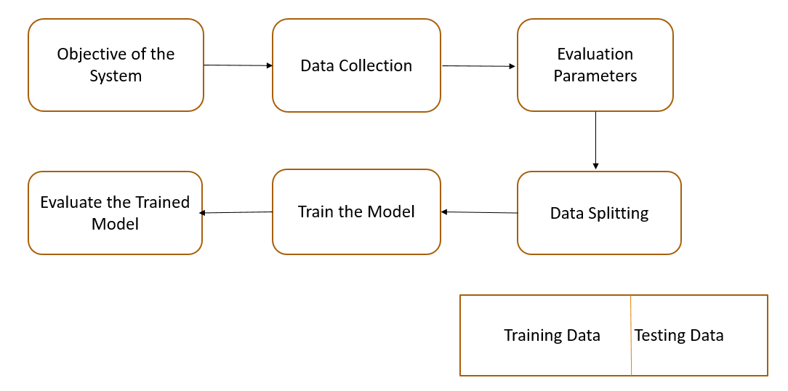
A General Machine Learning System

Slide 29
Regression Model Evaluation
R-squared is a statistical method that determines the goodness of fit.
It measures the strength of the relationship between the dependent and independent variables on a scale of 0-100%.
The high value of R-square determines the less difference between the predicted values and actual values and hence represents a good model.
It is also called a coefficient of determination, or coefficient of multiple determination for multiple regression.

Slide 30
1. Correlation
Correlation is a statistical measure that indicates the extent to which two or more variables fluctuate together.

Slide 31
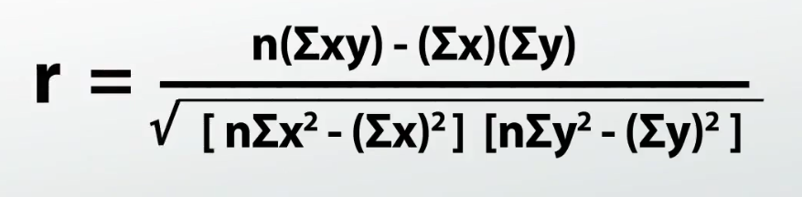
Pearson Correlation

Slide 32
2. R² : Coefficient of determination
R = r * r

Slide 33
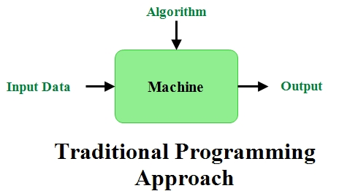
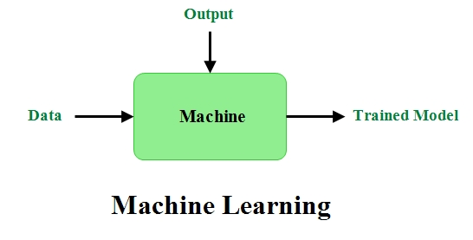
Programming Models

Slide 34
Thanks

